Slide 1
Measuring and Modeling Forest Carbon
Present:
Approaches to Measuring Forest Carbon Stocks
Approaches to Measuring Forest Carbon Fluxes
Dynamic Behavior of Forest Carbon Stocks
Separately for each key component:
Live C
Dead C
Soil C
Products

Slide 2
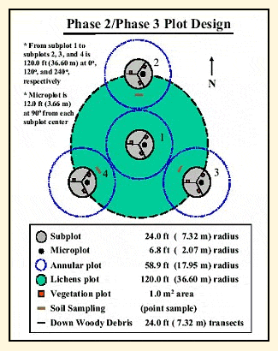
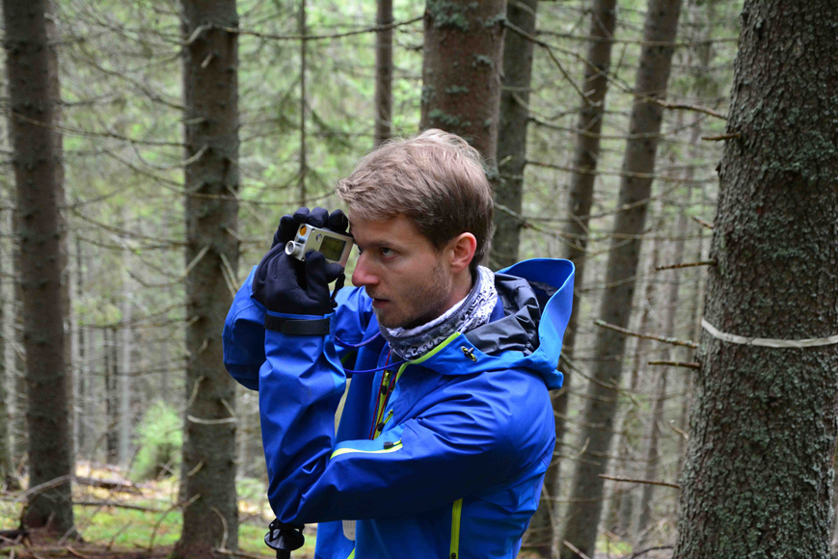
Live Forest Carbon: Measurement
The Carbon concentration of vegetation is extremely conserved at 50% mass fraction (slightly less for leaves and fine roots).
Consequently, live C inventories are similar to any forest volume inventory
Sample population of plots (~1 ha) to represent a landscape or condition
Frequency and size of trees (and other vegetation) surveyed in subplots

Slide 3
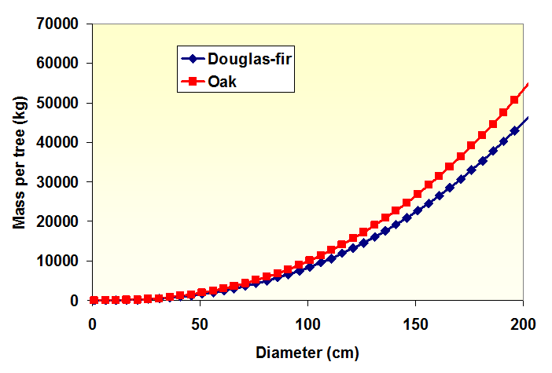
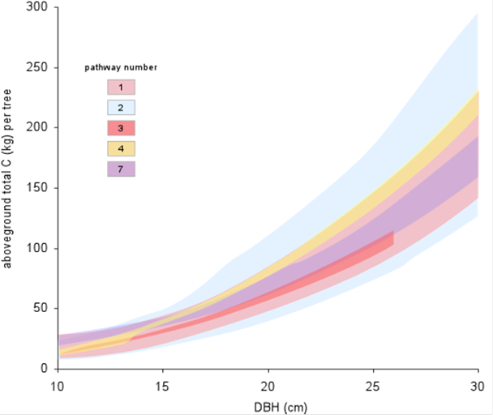
Live Forest Carbon: Measurement
Reliance on allometric relationships between field metrics and biomass
Typically take log-log form
Empirically-derived, site- and species- specific equations
Large source of error and potentially bias

Slide 4
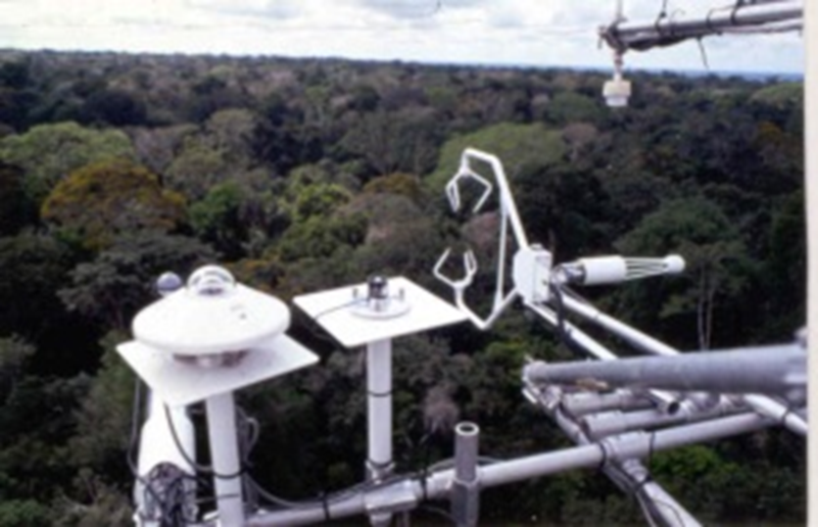
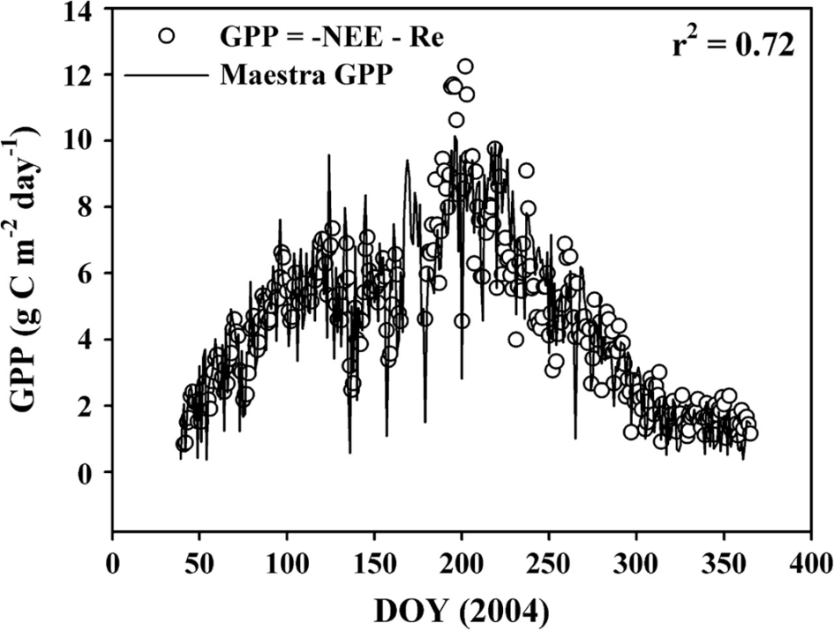
Live Forest Carbon: Fluxes
Eddy covariance instrumentation can measure instantaneous C flux between the forest and atmosphere
Simultaneous ultra-high frequency measurement of [CO2], air speed, and direction produces estimates of net uptake and release
Not particularly valuable in in evaluating long-term dynamics but extremely important in identifying environmental controls on ecosystem production

Slide 5
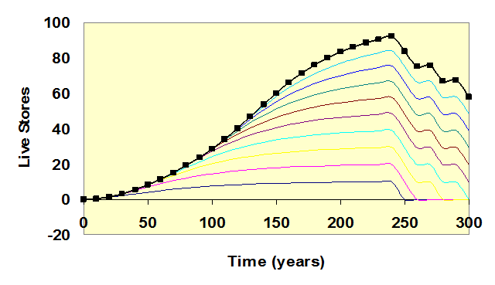
Live Forest Carbon: Behavior
Live biomass accumulation in one tree
Live biomass accumulation in a forest with continued recruitment
Without Mortality

Slide 6
Live Forest Carbon: Behavior
Live biomass accumulation in one tree
Live biomass accumulation in a forest with continued recruitment
With Mortality

Slide 7
Live Forest Carbon: Behavior
Empirical Trends observed in ~10,000 forest plots in the PNW
Live biomass accumulates overtime to a site-specific max (as theory would predict)
Deviation in realized biomass (solid line) from fitted limit (dashed line) increases with age
Hypothesis: cumulative background mortality plus stochastic partial disturbance
Hudiburg et al., 2008

Slide 8
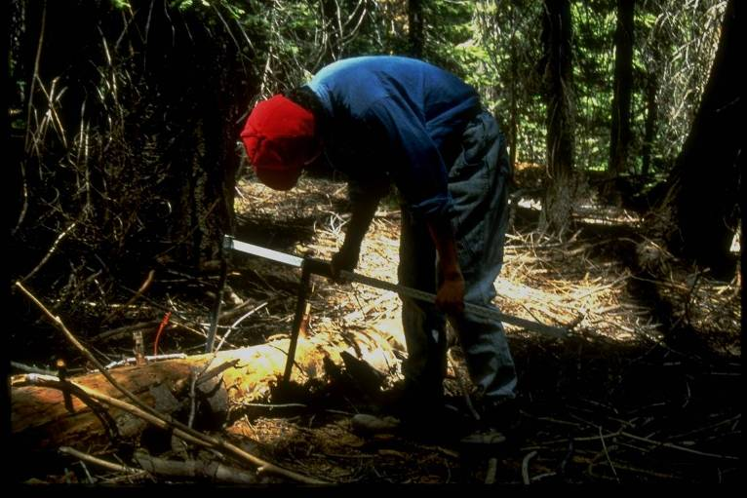
Dead Forest Carbon: Measuring Stores
Inventorying dead carbon basically involves either harvesting the material or measuring dimensions that can be converted into carbon units.
Dead standing trees: same as live tree inventory except that one must consider density loss due to decay state.
Fallen trees and branches: subplots or line-intercept (just like forest fuel assessment)
Litter and Duff: Direct sampling (dry and weigh)

Slide 9
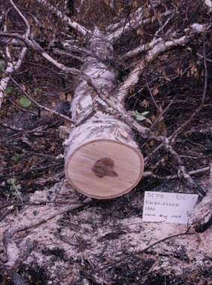
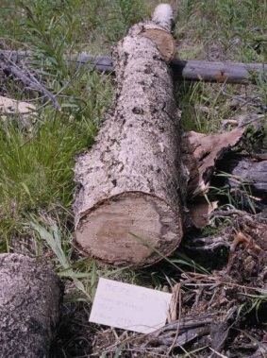
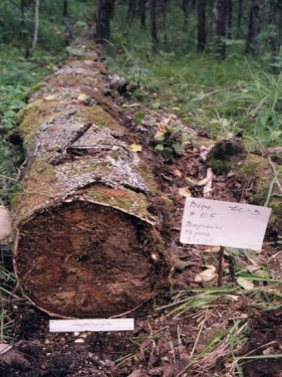
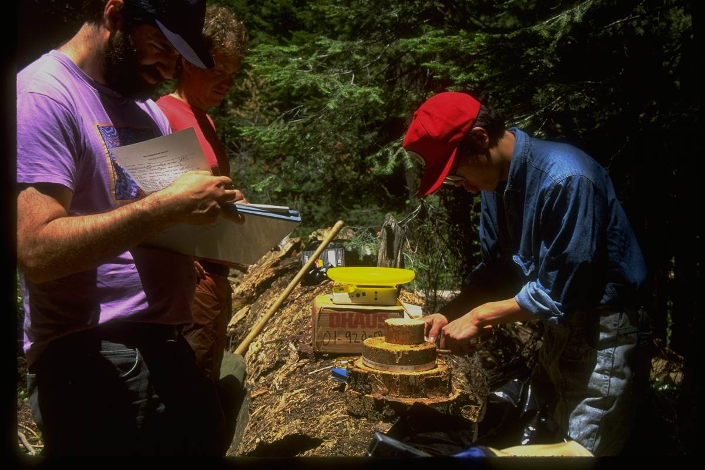
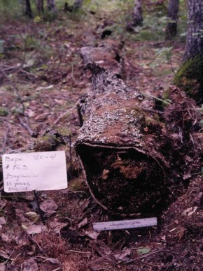
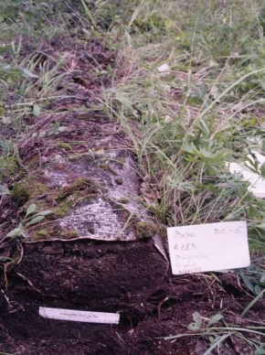
Dead Forest Carbon: Measuring Stores
To convert the volume of dead matter in each type and decay-class into mass one must use empirically-derived conversion factors.
Such “lookup tables” are painstakingly populated by collecting, drying, and weighing samples from each class of dead material

Slide 10
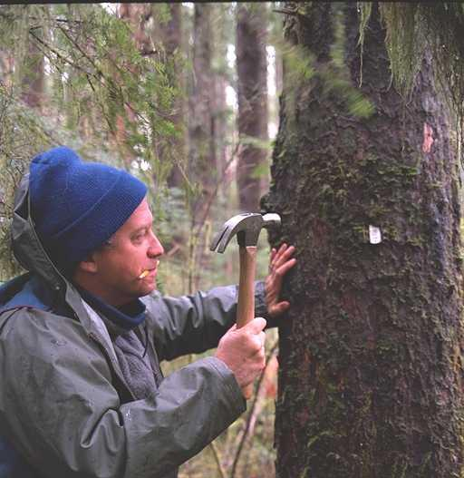
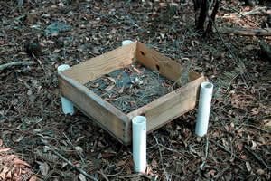
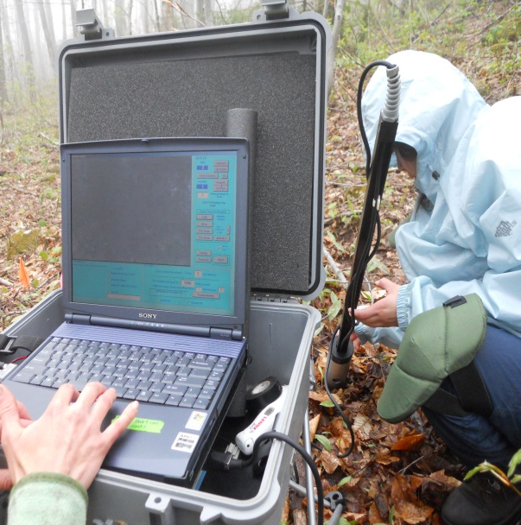
Dead Forest Carbon: Measuring Inputs
Standing stocks of dead C tells us what’s there, but to understand dynamics we want to know something about input rates (mortality) and losses (decay)
To quantify tree mortality and fall rate, individual trees must be tracked through time
Leaf and fine wood mortality (litterfall) measured in collection traps
Fine root mortality can be evaluated through sequential imaging (minirhizotron)

Slide 11
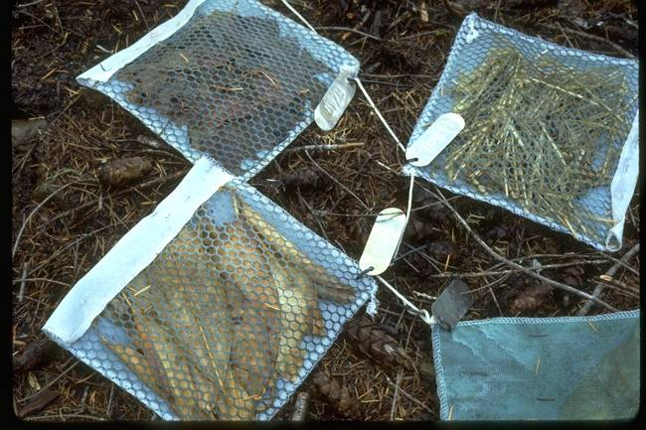
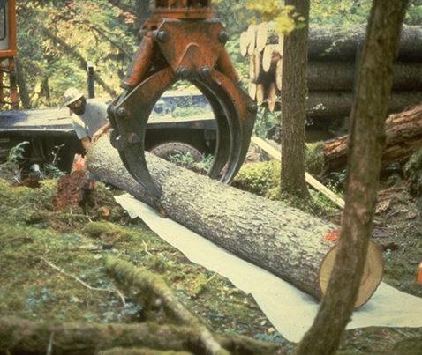
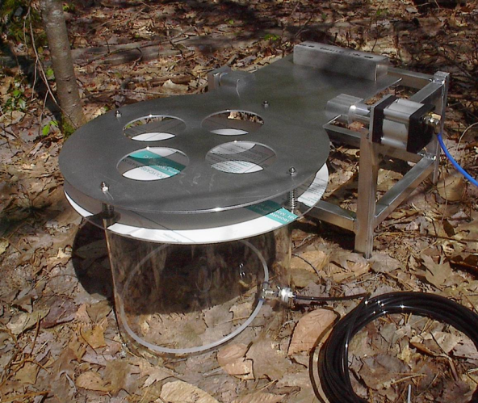
Dead Forest Carbon: Measuring Decay
Standing stocks of dead C tells us what’s there, but to understand dynamics we want to know something about input rates (mortality) and losses (decay)
Litter decomposition bags to quantify carbon losses via litter decomposition
Long-term monitoring of log decay
Losses of Carbon via “soil respiration” can be measured directly using IR gas analyzers

Slide 12
Dead Forest Carbon: Behavior
Generally speaking, 1st order decay constants adequately describe loss of carbon from dead forest pools
Rates vary by substrate: surface-to-volume ratio and chemical composition
Rates vary by environment: temperature and moisture

Slide 13
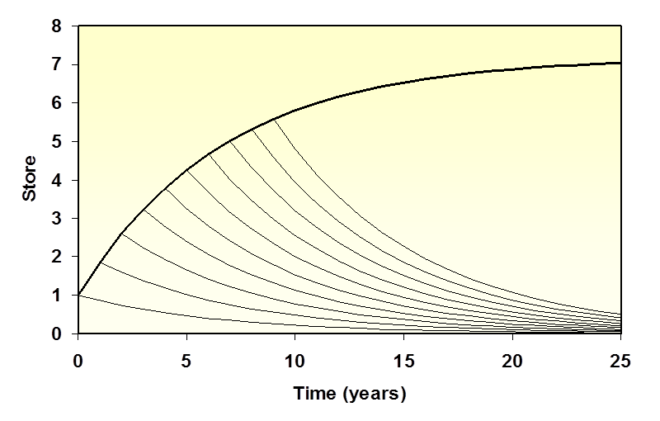
Dead Forest Carbon: Behavior
Decay of dead wood with inputs
Yes… dead wood pools can grow even as they decay

Slide 14
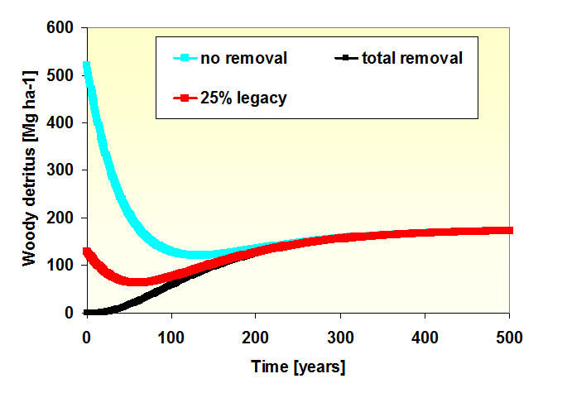
Dead Forest Carbon: Behavior
Dynamic patterns of dead wood mass over time

Slide 15
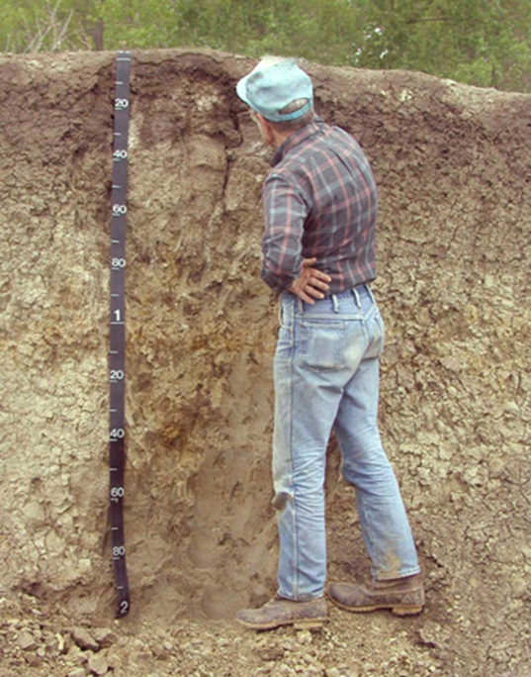
Soil Carbon: Measuring Stocks
Depth of the soil being sampled determines volume of soil
Rock content of the soil determines the amount of fine material <2 mm diameter
Bulk density of the soil being sampled determines the mass of the soil
Carbon concentration determines the carbon content per mass of soil
Soil C =Depth*(1-Rock Content)*Bulk Density* C Concentration

Slide 16

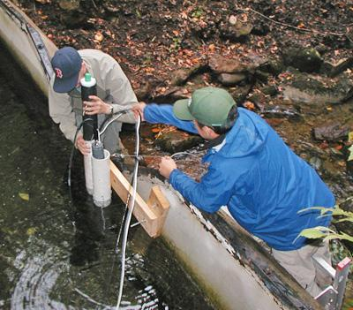
Soil Carbon: Measuring Changes
CO2 escape via soil respiration
Stocks straight-forward to measure but suffer from large sampling error.
We can reasonably determine long-term stocks, but it is very difficult to evaluate change.
To disentangle controls on inputs and outputs we employ flux measurements
Ultimately depend largely on empirical curves to fit long-term trends.
For C-accounting purposes, we generally assume equilibrium
DOC escape via stream flow

Slide 17
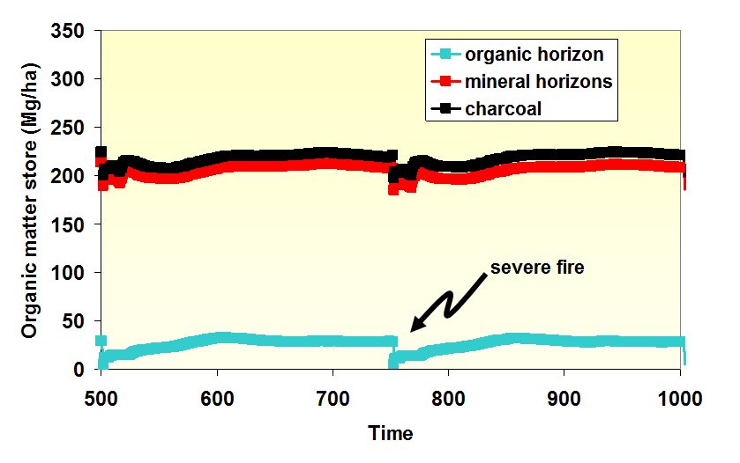
Soil Carbon: Behavior
Combining what we know into process models suggest relatively stable soil C with small disruptions associated with severe disturbance
Remember though, small changes in large pools can be important and not all forests will behave like this

Slide 18
Wood Product Carbon: Measurement
Constraints
These pools are not measured directly, they are typically modeled. Why?
  Harvested carbon travels far and wide
  It is used in many forms
  It has vastly different turnover times based on material, actual use, and location
  Some forms such as substitutions could never be directly inventoried

Slide 19
Wood Product Carbon: Measurement
Approaches
Manufacturing
  Track product type streams
  Apply estimated efficiencies
  Output to specific uses e.g., buildings
In-use and Disposal
  Empirical models with defined loss curves
  Process models with rate-constants

Slide 20
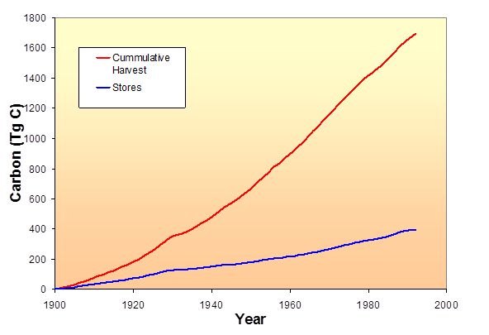
Wood Product Carbon: Behavior
Not all harvested wood makes it into a wood product (harvest >> product input)
Wood products do not last forever (accumulation rate < input rate )
At least some products last longer than the time required to replace them (accumulation rate > 0)

Slide 21
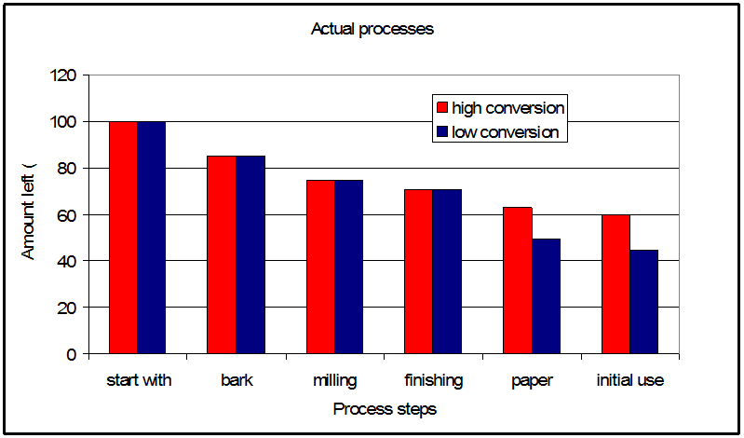
Wood Product Carbon: Behavior
Why is it so hard to get efficient transfer of forest carbon to product carbon?
Suppose you have 90% efficiency at each step of manufacturing, and you have 5 steps.
Collective efficiency = 0.90⁵ = 59%

Slide 22
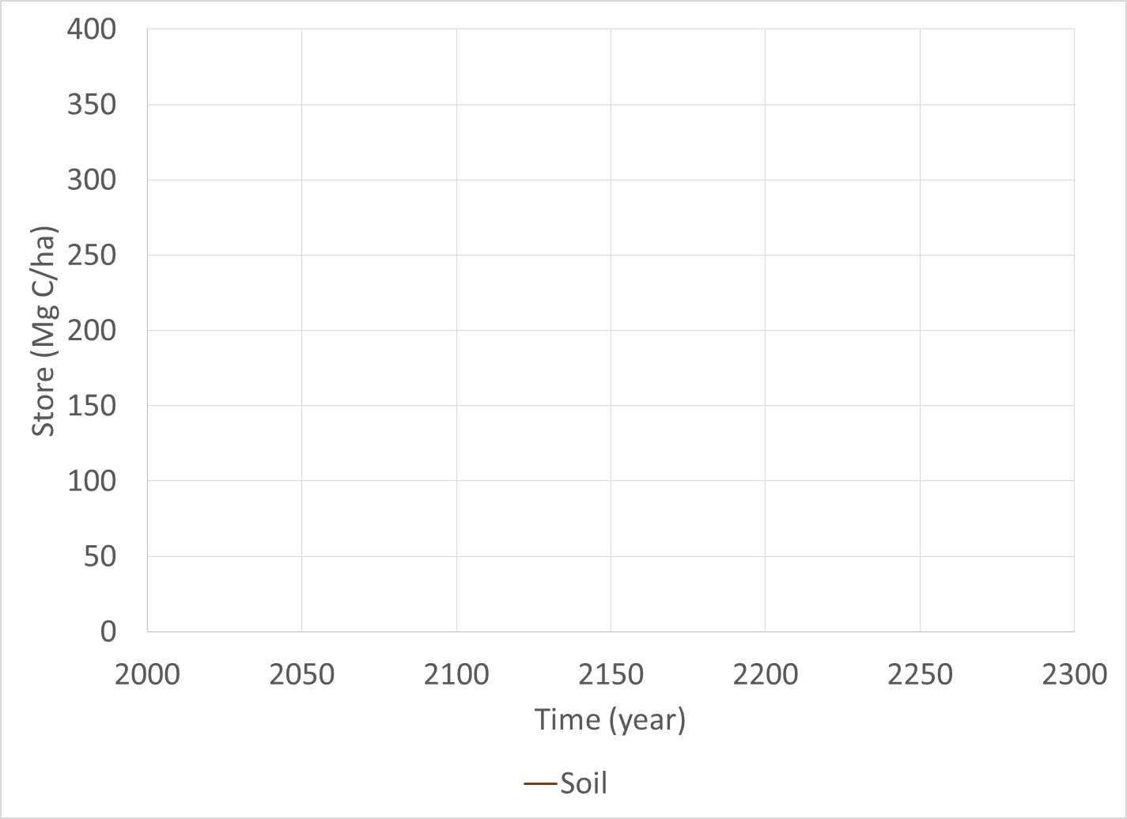
Putting it together

Slide 23
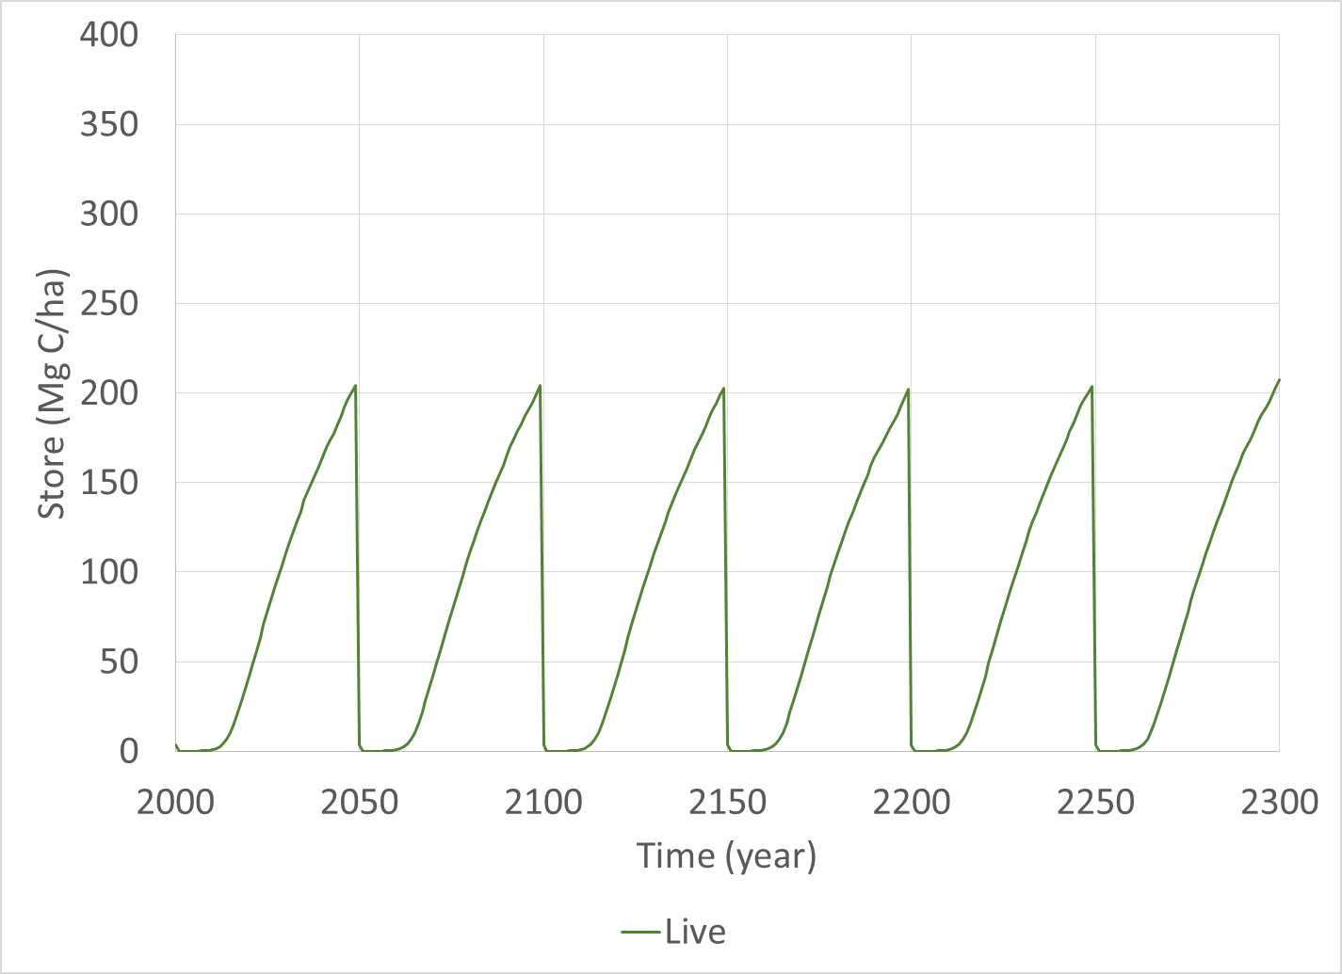

Slide 24
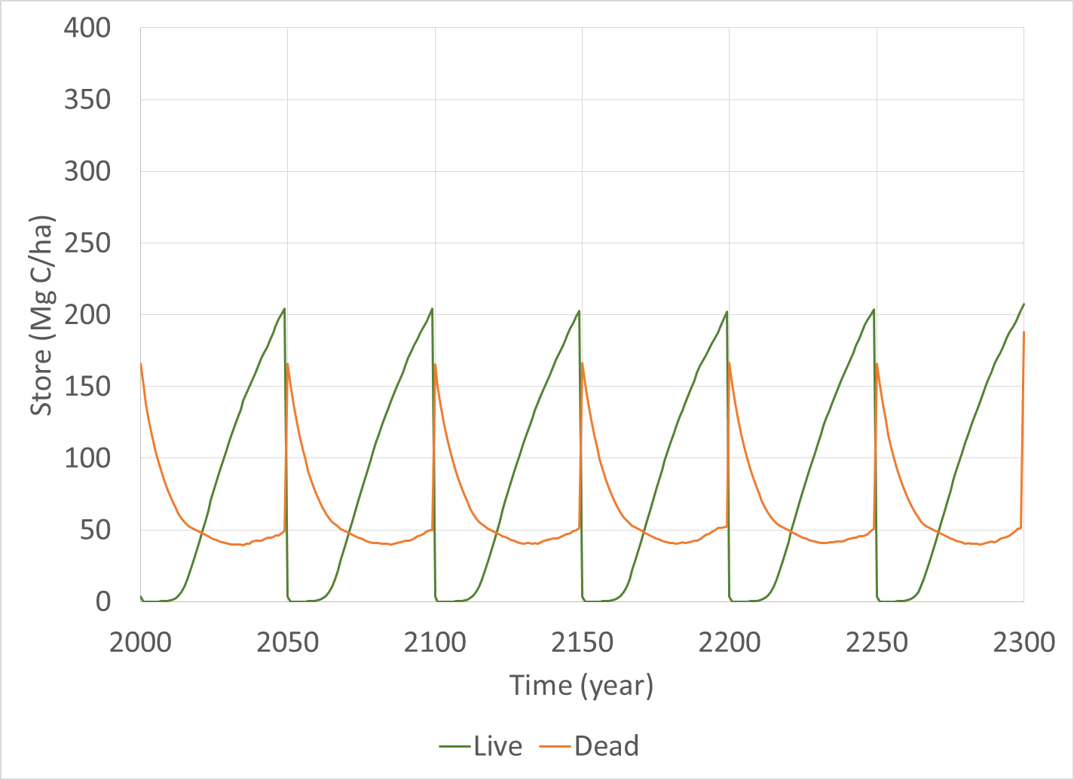

Slide 25
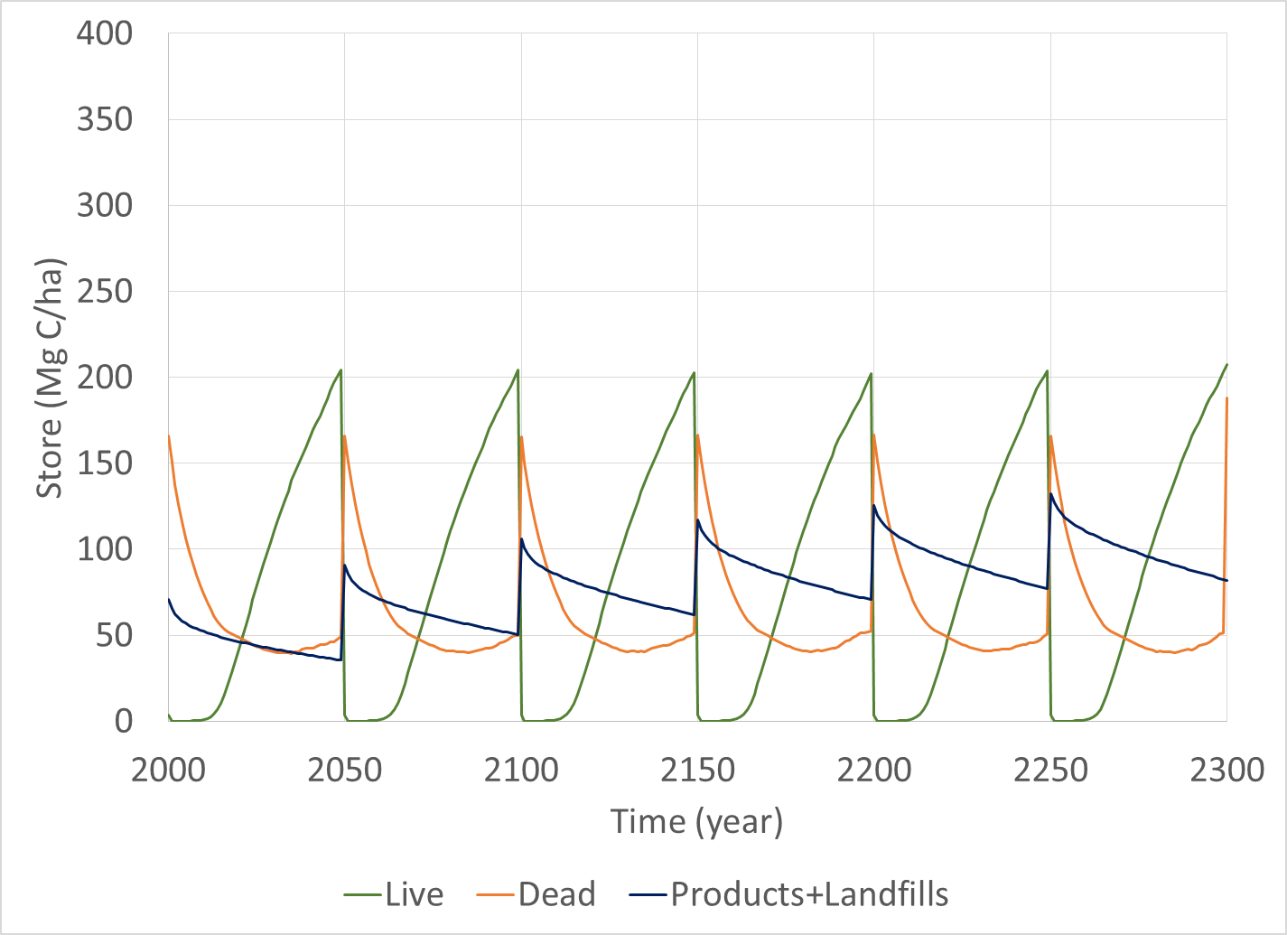

Slide 26
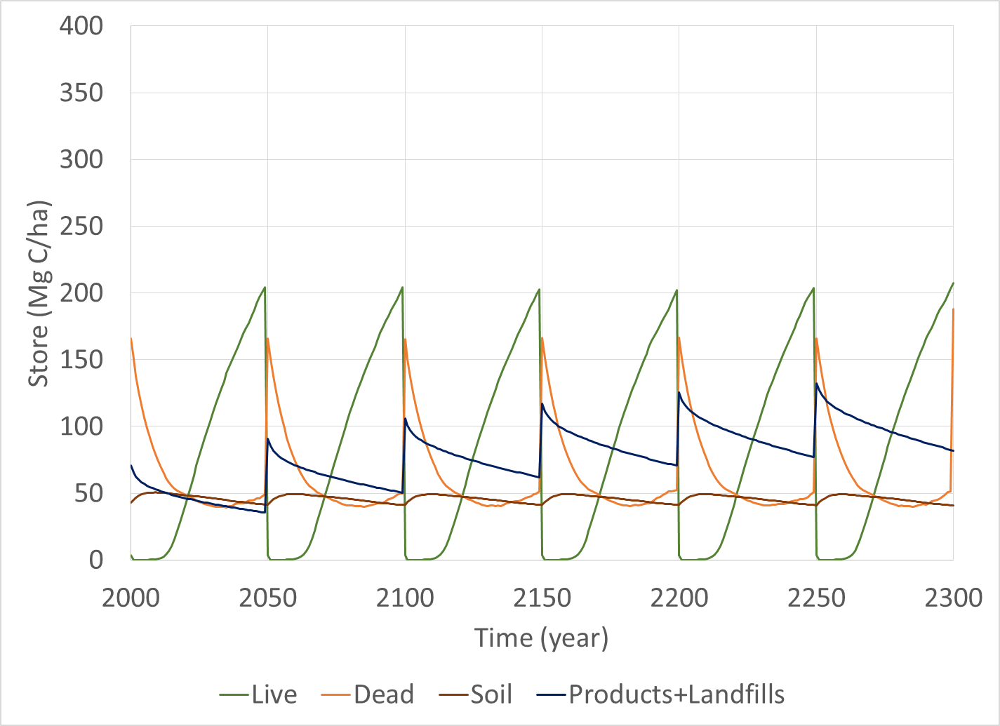

Slide 27
